Slide 1

ICT to empower disable: Exclusion to inclusion
Thanjida Akhter
Department of CSE
United International University

Slide 2
Agenda
Introduction
Disabilities
Statistics on Disability
ICT
Impact on Economy
What is inclusion?
Challenges and Barriers
ICT as types of at devices
ICT for inclusion
Peripherals
How to Empower Disable
Conclusion

Slide 3
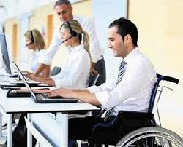
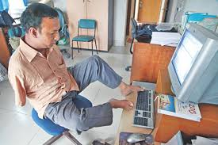
Introduction
“The worst thing about disability is that people see it before they see you.”
Easter Seals

Slide 4
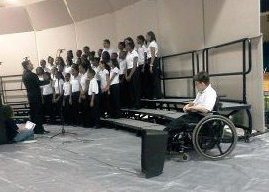

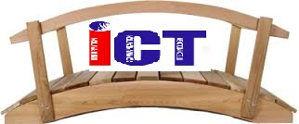
Introduction
We tried to find missing facts in developing countries to help the people with disabilities on the basis of current ICT technology that is available to us so that no disable people have to go through the emotional death.
ICT as a Bridge
Excluded Disable People
Included in Society

Slide 5






Disabilities
Disability is the consequence of an impairment that may be one of the following or a combination of them
Physical
Developmental
Cognitive
Sensory
Mental
Emotional

Slide 6
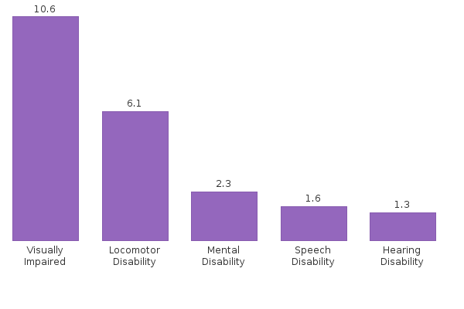
Statistics on Disability
More than 1 Billion Disable People present in the world.
80% of those are in Developing Countries.

Slide 7

Information and Communications Technology (ICT)
Information and Communications Technology (ICT)
Any communication device or application encompassing
Radio, Television, Cellular phones, Computer, Network, Hardware and software, satellite systems and so on,
Various services and applications e.g., Online learning, Communication Apps.
Notes:
Information and Communications Technology - or Technologies is an umbrella term that includes any communication device or application encompassing: radio, television, cellular phones, computer and network ,hardware and software, satellite systems and so on, as well as the various services and applications associated with them, such as videoconferencing and distance learning.

Slide 8

Impact on Economy
A very simple logic tells us that if 0.8 billion disable people of developing countries start earning 1$ per day then
2400000000 $ per month
28800000000 $ per year
which is a huge impact on our
economy
Date: 03-12-15

Slide 9
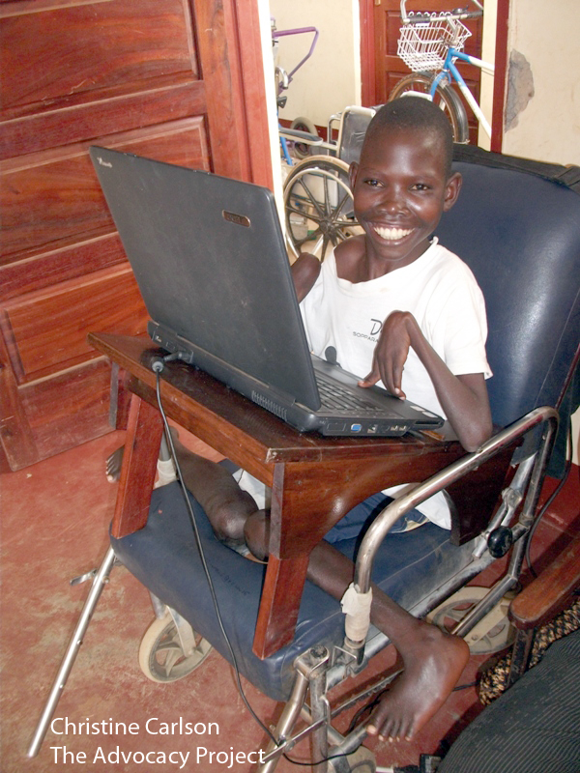

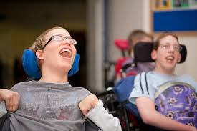
What is inclusion?
All people should freely, openly and without pity accommodate any person with a disability without restrictions or limitations of any kind

Slide 10
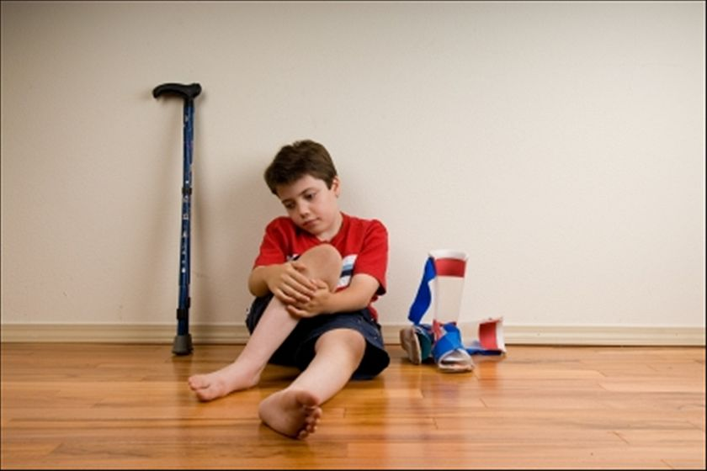
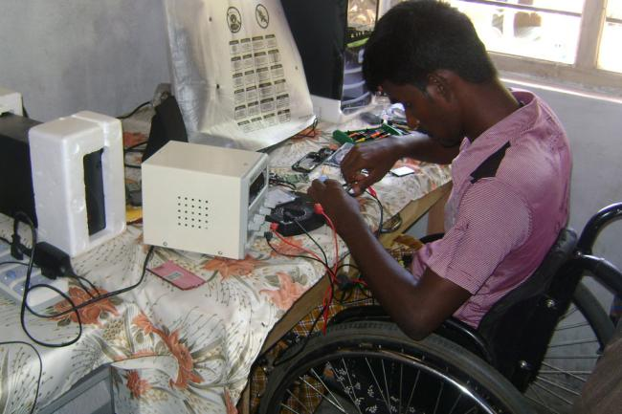
Challenges
To bring them to the mainstream of the society and making them self sustainable to the extent possible

Slide 11
Barriers
Inadequate Education Facilities
Lack of Community Support Systems
Lack of Accessibility & Awareness
Lack of Access to Technology
Inadequate Health Care Systems
Inadequacy of ICT equipment
Motivation of their family as well as society
Cooperativeness
Cost

Slide 12
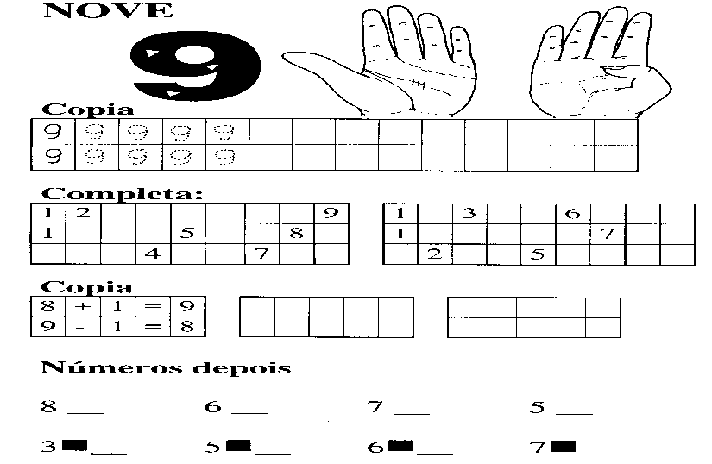
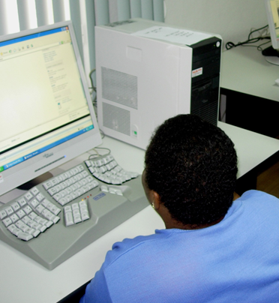
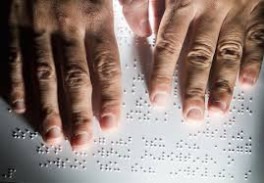
ICT as types of AT devices?
Low-tech
Medium-tech
High-tech
sign language
Adapting Computer
Braille paper

Slide 13
ICT FOR INCLUSION
Individual level
Systemic/Institutional level
Notes:
Assistive technology (AT) is any item, piece of equipment, service or product system whether acquired commercially on the shelf, modified or customized, that is used to increase, maintain, or improve functional capabilities of individuals with disabilities.
It can be a very complex and multifaceted field, yet in some cases be a relatively easy and creative problem solving process
Includes a range of technologies, which enable people to build on their abilities and participate as fully as possible at home, school, work and in their community

Slide 14
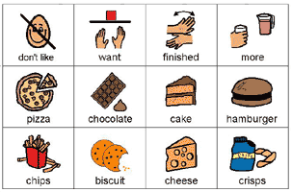
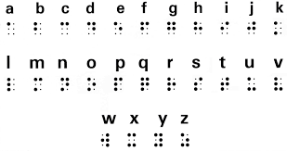
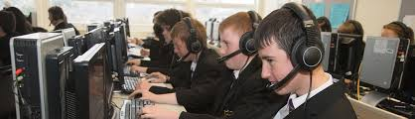
INDIVIDUAL LEVEL
Education
Braille, Pictorial communication, Large Print, Personalized environment
Rehabilitation/Inclusion
Physiotherapy, Beauty care, Call center, office jobs, Bank, Court etc.
Communication
Voice commands, Descriptors, Large Print
Pictorial communication
Braille

Slide 15
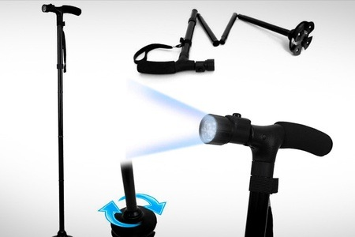
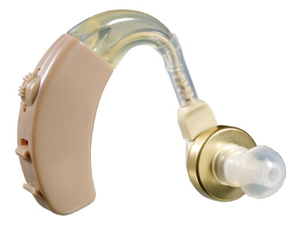
INDIVIDUAL LEVEL
Some Gadgets available
Visual Impairment
Braille shorthand machine
Distance vision telescopes
Handheld magnifiers
KNFB portable reader for blind people
Talking dictionary
Smart Cane
Speech Impairment
Delayed Auditory Feedback (DAF)
Hearing Impairment
Advanced Digital Speech Audiometer
Hearing Aid
Wireless FM Assistive Listening System
Smart Cane
Hearing Aid

Slide 16
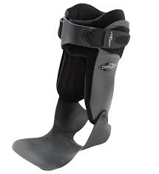
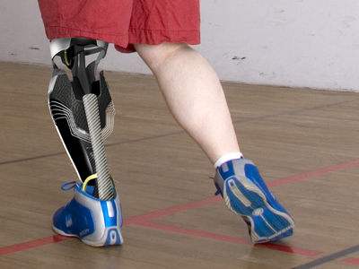

INDIVIDUAL LEVEL
Locomotor Impairment
Battery Powered Joystick Operated Wheelchair
Aluminum Crutches
Ankle Brace for ankle support
Prosthetic limbs
Cervical Immobilizer
Child model tricycle
Folding sticks and folding walkers
Mental Retardation
Basic Skill Wooden Puzzles
We can (daily living activities)
Calendar of seasons
Punnarjani
Cerebral Palsy
Sanyog
Gupshup
Switches
Ankle Brace
Prosthetic limbs
Puzzle

Slide 17
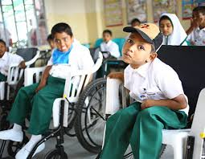
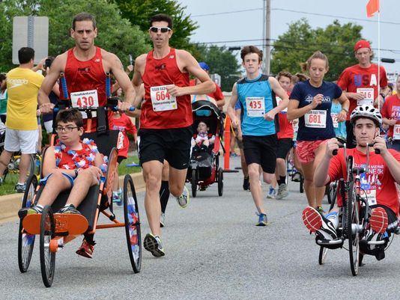
SYSTEMIC / INSTITUTIONAL LEVEL
Any tool or service that is helpful in advancing student learning
An evidence-based applied science derived from basic educational and psychological research
Enhances capabilities of exploring ideas, innovations and communicating meanings

Slide 18
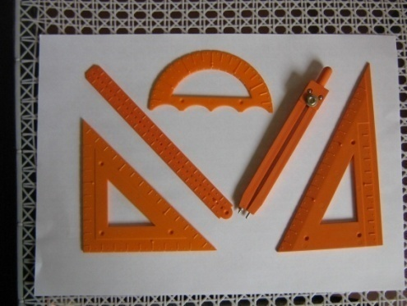
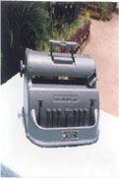
SYSTEMIC / INSTITUTIONAL LEVEL
Examples of some AT to help PWDs in education includes –
Braille Duplicators and Writers
Group Hearing Aid for classrooms
Alternative & Augmentative Communication software/devices
Multi-Sensory systems
Tactile mathematical devices

Slide 19
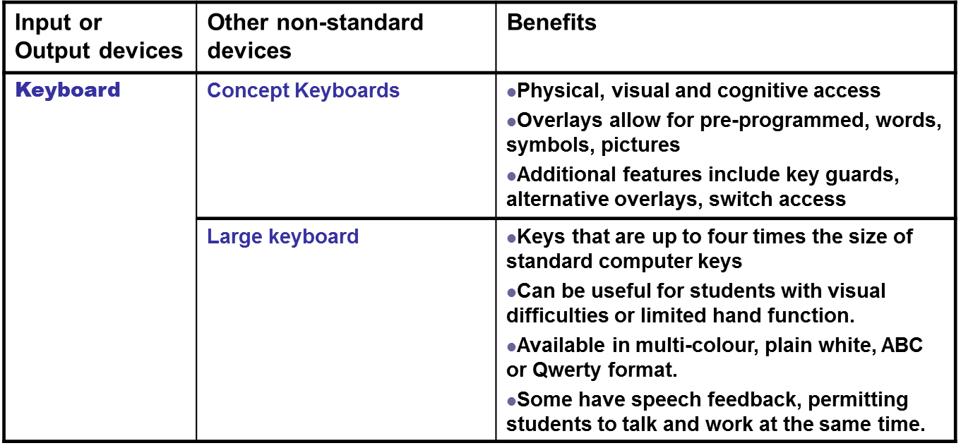
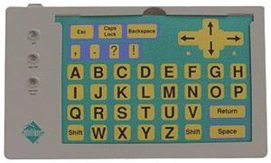

Peripherals

Slide 20
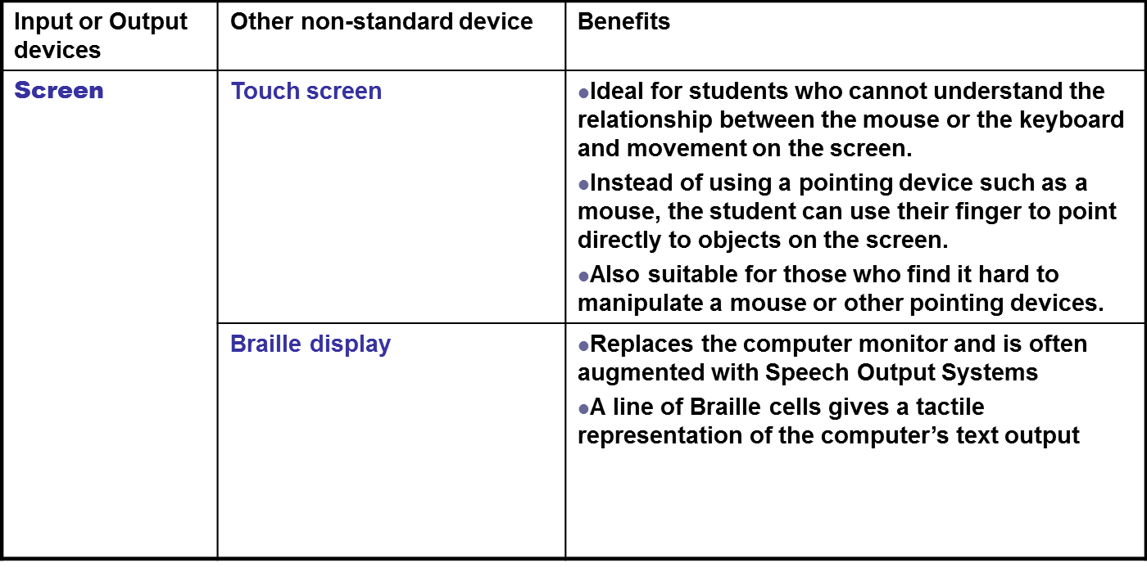
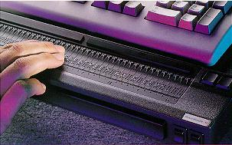
Peripherals

Slide 21
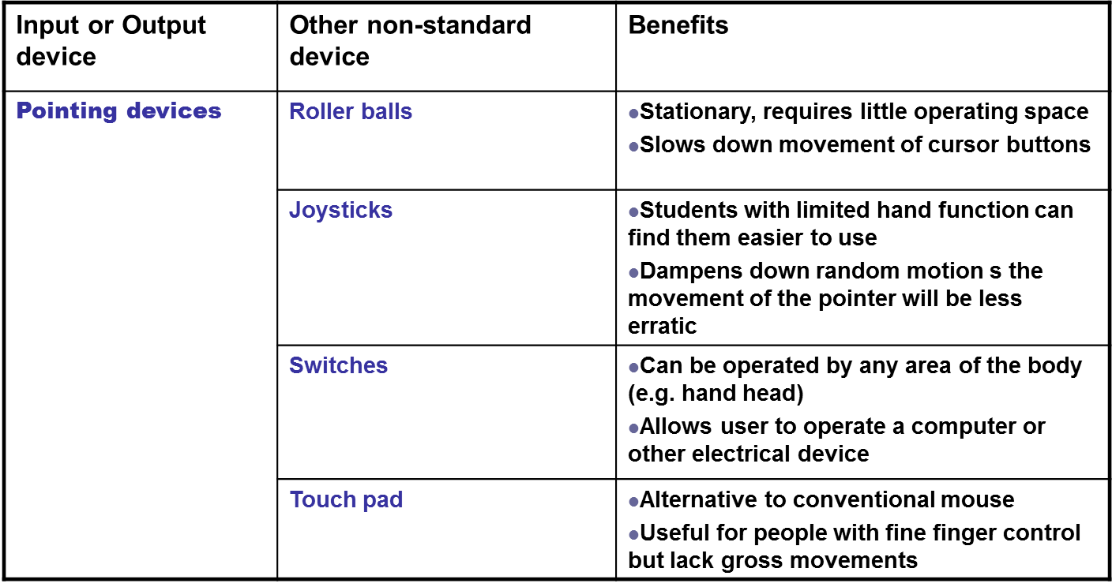

Slide 22
How to Empower Disable
Some major area where ICT can be very effective for disable people are
Education
Health
Basic Life Style
Job
Mind Awareness
Confidence
Date: 03-12-15

Slide 23

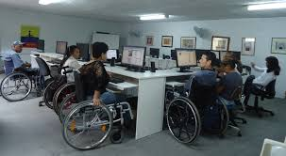
How to Empower Disable
Distance Learning and e-Learning for disable
Single or Group learning
Date: 03-12-15

Slide 24
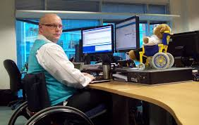
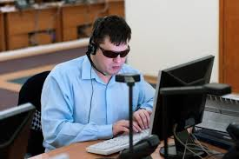
How to Empower Disable
ICT can help disables to do jobs in different aspects of life like in a call centre, data centre etc.
Date: 03-12-15

Slide 25
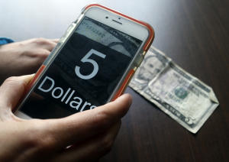
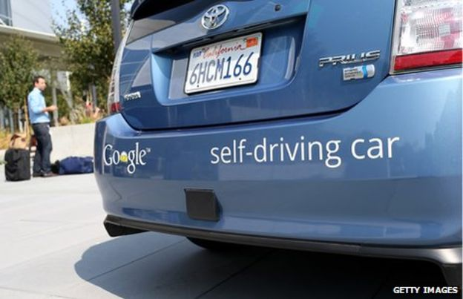
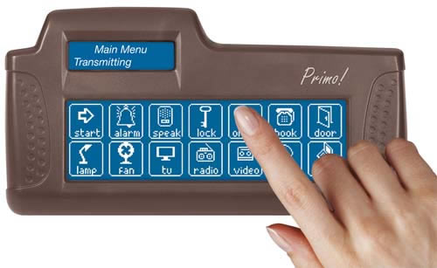
How to Empower Disable
Different kind of Apps in Smart phones like
Money recognizer for blind person
Automated Car to carry PwD by GPS
Date: 03-12-15

Slide 26
Conclusion
There may be many questions regarding the application of Technology in Serving Persons with Disabilities
But
Use of Technology becomes inevitable in the growing technological world
Date: 03-12-15

Slide 27

Thank you for your attention!

